Slide 1
Analyzing community data with joint species distribution models
abundance, traits, phylogeny, co-occurrence and spatio-temporal structures
Otso Ovaskainen
University of Helsinki, Finland
NTNU Trondheim, Norway
Global

Slide 2
What structures the assembly and dynamics of communities?
Leibold et al. (2004): The dynamics and distributions of communities are shaped by the interplay between
environmental filtering
species interactions
spatial and stochastic processes
Logue et al. (2011): Metacommunity theories are still poorly linked with data. There is a lack of statistical frameworks that would enable one to infer metacommunity processes from data typically available in community ecological studies.

Slide 3
Data typically available for community ecological studies
Y
X
Occurrence
Environment
Space and time
sampling units
2000
1980
species
covariates
C
T
Phylogeny
Traits
species
species
traits

Slide 4

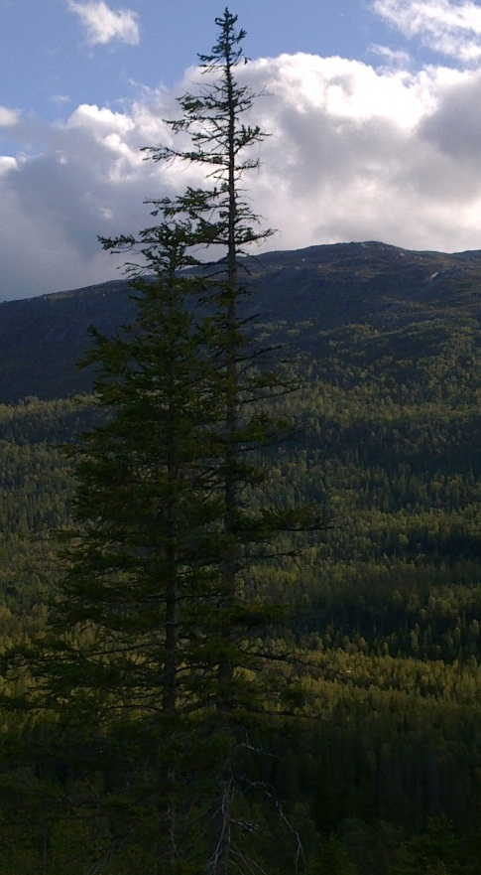
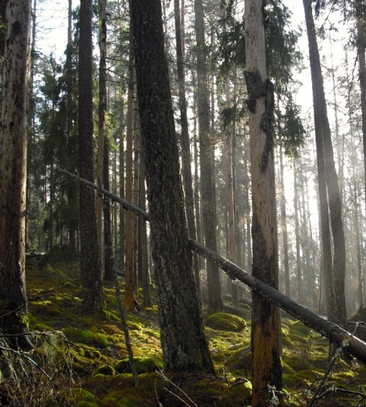
A statistical framework for community ecology
Evolutionary processes
phylogenetic
relationships
Helmus et al. 2007, Ives and Helmus 2011
species traits
Dorazio and Connor 2014
Spatial and neutral processes
Biotic interactions
Global
Pollock et al. 2012,
Brown et al. 2014,
Ovaskainen et al. 2015a.
Regional
Latimer et al. 2009 , Blangiardo et al. 2013, Borcard and Legendre 2002, Dray et al. 2006, Dray et al. 2012, Thorson et al. 2015, Ovaskainen et al 2015b
le Roux et al. 2014, Pellissier et al. 2013, Ovaskainen et al. 2010, Sebastian-Gonzalez et al. 2010, Pollock et al. 2014, Clark et al. 2014, Ovaskainen et al. 2015a
global species pool
regional species pool
Environmental filtering
Local
local species pool
observed community
Dorazio and Royle 2005, Dorazio et al. 2006, Kery et al. 2009, Russell et al. 2009, Dorazio et al. 2010, Zipkin et al. 2010, Ovaskainen and Soininen 2011, Jackson et al. 2012, Olden et al. 2014, Dunstan et al. 2011, Hui et al. 2013, Ovaskainen et al. 2015ab
Dorazio and Royle 2005, Dorazio et al. 2006, Kery et al. 2009, Russell et al. 2009, Dorazio et al. 2010, Zipkin et al. 2010
Sampling process
different diversity measures
Environmental variation

Slide 5
SDM (species distribution model)
Y
X
Occurrence
Environment
Space and time
sampling units
2000
1980
species
covariates
C
T
Phylogeny
Traits
species
species
traits

Slide 6
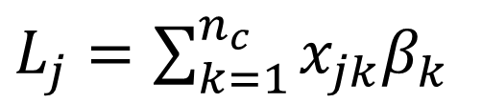
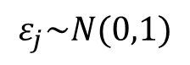
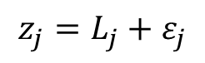
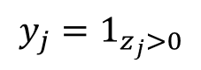
SDM (species distribution model)
Linear predictor for sampling unit j
environmental covariates
regression parameters
$L_{j}=\sum_{k=1}^{n_{c}}{x_{jk}β_{k}}$
Example link function: probit regression for presence-absence data
Species occurrence:
$$y_{j}=1_{z_{j}>0}$$
Latent occurrence score:
$$z_{j}=L_{j}+ε_{j}$$
Residual:
$$ε_{j}\sim N(0,1)$$

Slide 7
JSDM (joint species distribution model)
Y
X
Occurrence
Environment
Space and time
sampling units
2000
1980
species
covariates
C
T
Phylogeny
Traits
species
species
traits

Slide 8
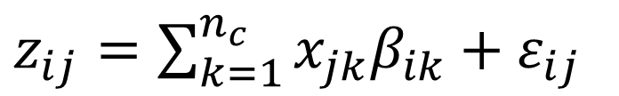
JSDM (joint species distribution model)
environmental covariates
regression parameters
$z_{ij}=\sum_{k=1}^{n_{c}}{x_{jk}β_{ik}+ε_{ij}}$
Latent occurrence score for species i in sampling unit j
residual
Approaches to community modelling (Ferrier and Guisan, 2006):
‘assemble first, predict later’
‘predict first, assemble later’
‘assemble and predict together’

Slide 9
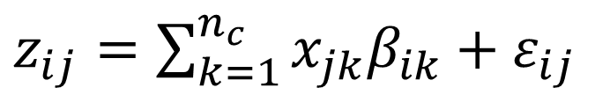
JSDM (joint species distribution model)
environmental covariates
regression parameters
$z_{ij}=\sum_{k=1}^{n_{c}}{x_{jk}β_{ik}+ε_{ij}}$
Latent occurrence score for species i in sampling unit j
residual
Approaches to community modelling (Ferrier and Guisan, 2006):
‘assemble first, predict later’
‘predict first, assemble later’
‘assemble and predict together’

Slide 10
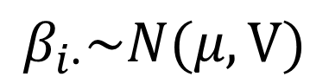
JSDM (joint species distribution model)
environmental covariates
regression parameters
$z_{ij}=\sum_{k=1}^{n_{c}}{x_{jk}β_{ik}+ε_{ij}}$
Latent occurrence score for species i in sampling unit j
residual
$$β_{i∙}\sim N(μ,V)$$
Species level
Community level

Slide 11
Example: borrowing information from other species to parameterize models for rare species
500 diatom species surveyed for presence-absence on 105 sampling units (streams)
Training data: 35 sampling units
Validation data: 70 sampling units
training data
Number of species
full data
independent models, prior 1
independent models, prior 2
community model, prior 1
community model, prior 2
Number of sites
Ovaskainen and Soininen (Ecology, 2011)
Oldén et al. (Plos one, 2014)

Slide 12
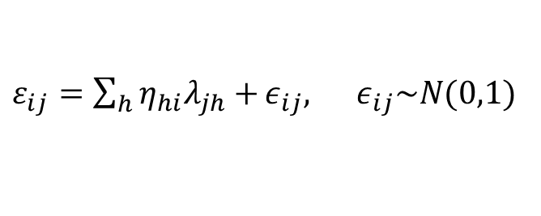
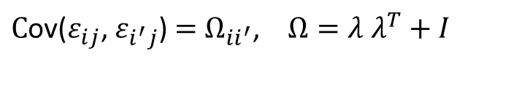
JSDM (joint species distribution model)
environmental covariates
regression parameters
$z_{ij}=\sum_{k=1}^{n_{c}}{x_{jk}β_{ik}+ε_{ij}}$
Latent occurrence score for species i in sampling unit j
residual
Modelling co-occurrence through latent factors
latent factors
factor loadings
$ε_{ij}=\sum_{h}{η_{hi}λ_{jh}+}ε_{ij}, ε_{ij}\sim N(0,1)$
$C$ov($ε_{ij}$, $ε_{i^{′}j}$) $=$ $Ω_{ii^{′}}$, $Ω=λ$ $λ^{T}+I$
Ovaskainen et al. (Methods in Ecology and Evolution, 2015a)
Warton et al. (TREE, 2015)

Slide 13

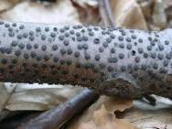
Example: co-occurrence among wood-inhabiting fungi
P(positive association)>0.95
P(negative association)>0.95
Ovaskainen et al. (Methods in Ecology and Evolution, 2015a)

Slide 14
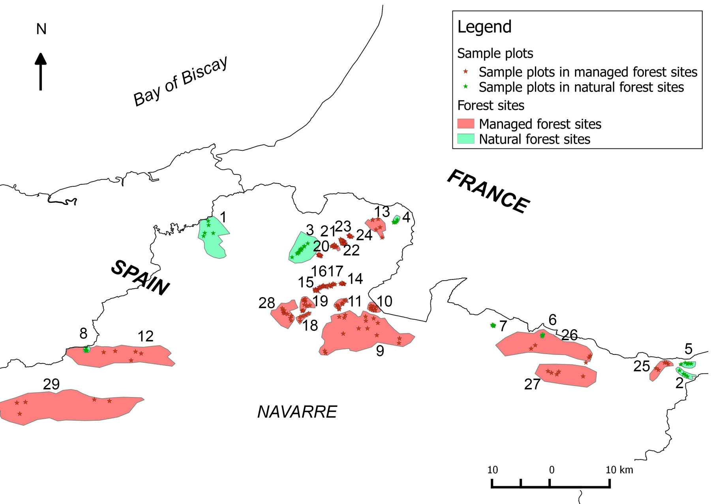
Co-occurrence can be estimated at multiple spatial scales
Resource unit
Plot
Forest
Total
Ovaskainen et al. (Methods in Ecology and Evolution, 2015a)

Slide 15
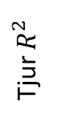
Accounting for co-occurrence improves model predictions
Prediction based on covariates and the occurrences of other species
Prediction based on covariates only
Tjur $R^{2}$
Prevalence
Ovaskainen et al. (Methods in Ecology and Evolution, 2015a)

Slide 16
Latent variables can be viewed as model based ordination
Model-based biplots for alpine plant data, from Warton et al. (TREE, 2015)

Slide 17
TJSDM (trait-based joint species distribution model)
Y
X
Occurrence
Environment
Space and time
sampling units
2000
1980
species
covariates
C
T
Phylogeny
Traits
species
species
traits

Slide 18
TJSDM (trait-based joint species distribution model)
environmental covariates
regression parameters
$z_{ij}=\sum_{k=1}^{n_{c}}{x_{jk}β_{ik}+ε_{ij}}$
Latent occurrence score for species i in sampling unit j
residual

Slide 19
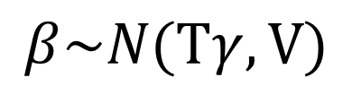
TJSDM (trait-based joint species distribution model)
environmental covariates
regression parameters
$z_{ij}=\sum_{k=1}^{n_{c}}{x_{jk}β_{ik}+ε_{ij}}$
Latent occurrence score for species i in sampling unit j
traits
regression parameters: how traits influence the species responses to environmental covariates
$$β\sim N(Tγ,V)$$
Species level
Community level

Slide 20
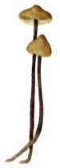
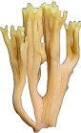
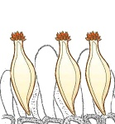

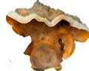

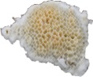
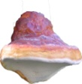

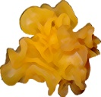
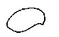
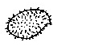
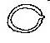
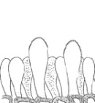
Example: distribution of fungal traits
Life-form
agaricoid
resupinate corticioid
pileate corticioid
discomycetoid
resupinate polyporoid
pileate polyporoid
ramarioid
stromatoid
tremelloid
spore
ornamentation
presence of
asexual structures
spore cell wall
spore size
Natural forests
30 µm
50 µm
0%
40%
0%
15%
30%
70%
Most abundant group
Least abundant group
Abrego, Norberg and Ovaskainen (in prep)

Slide 21
Example: distribution of fungal traits
Life-form
agaricoid
resupinate corticioid
pileate corticioid
discomycetoid
resupinate polyporoid
pileate polyporoid
ramarioid
stromatoid
tremelloid
spore
ornamentation
presence of
asexual structures
spore cell wall
spore size
Natural forests
30 µm
50 µm
0%
40%
0%
15%
30%
70%
Most abundant group
Least abundant group
Less common in managed forests
More common in managed forests
Managed forests
P(difference between natural and managed forests)>0.95
Abrego, Norberg and Ovaskainen (in prep)

Slide 22

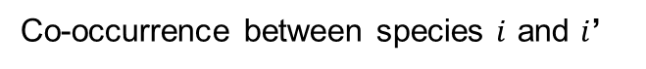
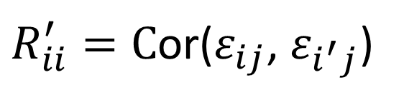
TJSDM (trait-based joint species distribution model)
environmental covariates
regression parameters
$z_{ij}=\sum_{k=1}^{n_{c}}{x_{jk}β_{ik}+ε_{ij}}$
Latent occurrence score for species i in sampling unit j
residual
$R_{ii}^{′}=C$or($ε_{ij}$, $ε_{i^{′}j}$)
Co-occurrence between species $i$ and $i$’
$$R=R(T)$$

Slide 23
PTJSDM (phylogenetically constrained trait-based joint species distribution model)
Y
X
Occurrence
Environment
Space and time
sampling units
2000
1980
species
covariates
C
T
Phylogeny
Traits
species
species
traits

Slide 24
PTJSDM (phylogenetically constrained trait-based joint species distribution model)
Y
X
Occurrence
Environment
Space and time
sampling units
2000
1980
species
covariates
C
T
Phylogeny
Traits
species
species
traits

Slide 25
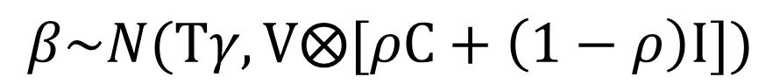
PTJSDM (phylogenetically constrained trait-based joint species distribution model)
environmental covariates
regression parameters
$z_{ij}=\sum_{k=1}^{n_{c}}{x_{jk}β_{ik}+ε_{ij}}$
Latent occurrence score for species i in sampling unit j
residual
$$β\sim N(Tγ,V⨂[ρC+\left(1−ρ\right)I])$$
Species level
Traits
Strength of phylogenetic signal
Phylogenetic relationship matrix
Ives and Helmus (Ecological Monographs, 2011)

Slide 26
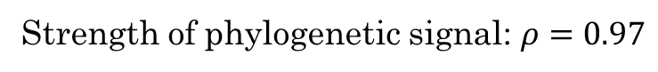
Example: distribution of fungal traits is correlated with phylogeny
Strength of phylogenetic signal: $ρ=0.97$
Life-form
agaricoid
resupinate corticioid
pileate corticioid
discomycetoid
resupinate polyporoid
pileate polyporoid
ramarioid
stromatoid
tremelloid
spore
ornamentation
presence of
asexual structures
spore cell wall
spore size
Natural forests
30 µm
50 µm
0%
40%
0%
15%
30%
70%
Most abundant group
Least abundant group
Abrego, Norberg and Ovaskainen (in prep)

Slide 27
STSDM (spatio-temporal species distribution model)
Y
X
Occurrence
Environment
Space and time
sampling units
2000
1980
species
covariates
C
T
Phylogeny
Traits
species
species
traits

Slide 28
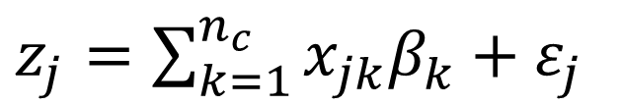
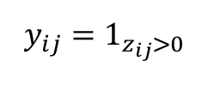
STSDM (spatio-temporal species distribution model)
regression parameters
environmental covariates
$z_{j}=\sum_{k=1}^{n_{c}}{x_{jk}β_{k}+ε_{j}}$
Latent occurrence score for species i in sampling unit j
residual
$C$ov($ε_{j}$, $ε_{j^{′}})=f(d_{jj^{′}})$
Spatial, temporal or spatio-temporal covariance

Slide 29
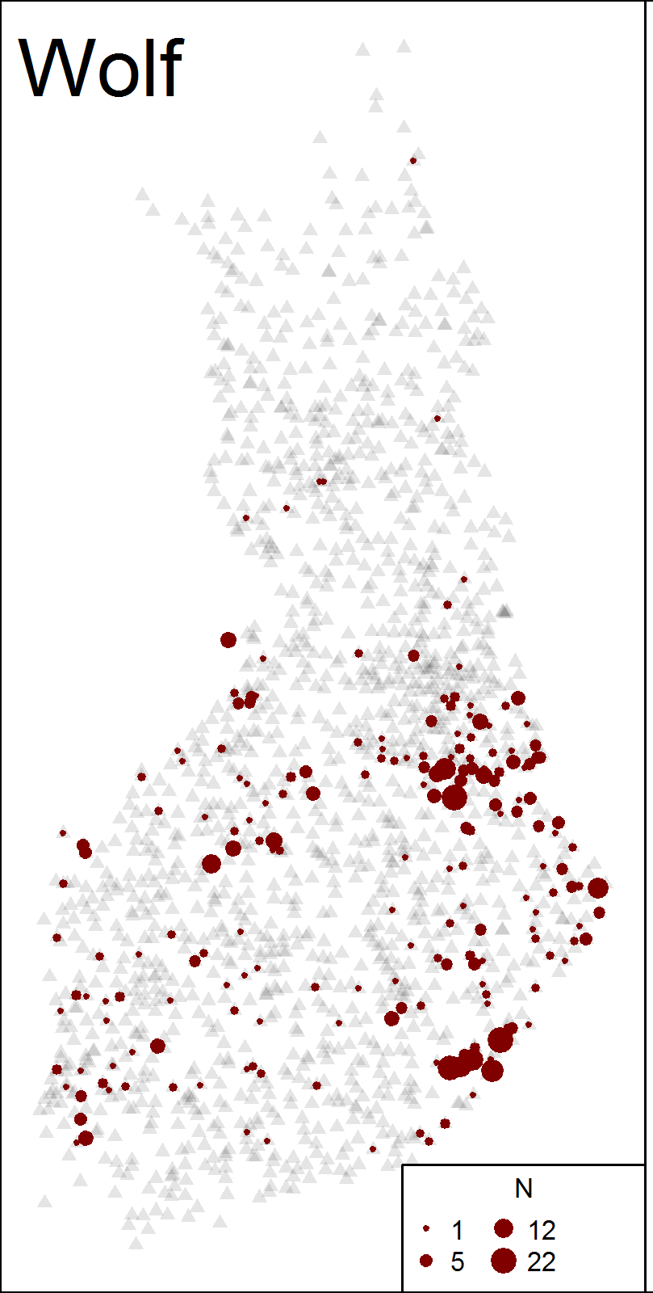
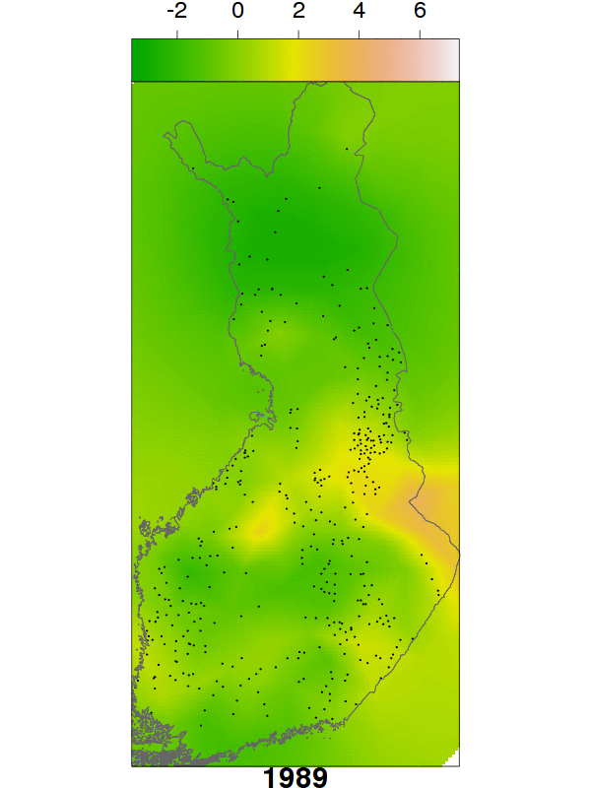
Example: inferring spatio-temporal population dynamics of wolf from winter-track data
The data
The fitted model
Jousimo et al. (in prep)

Slide 30
STJSDM (spatio-temporal joint species distribution model)
Y
X
Occurrence
Environment
Space and time
sampling units
2000
1980
species
covariates
C
T
Phylogeny
Traits
species
species
traits

Slide 31
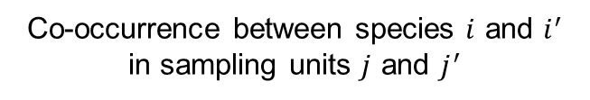
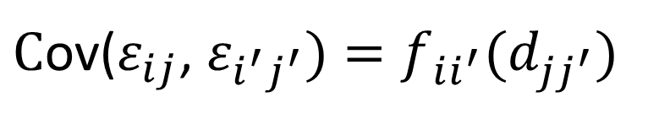
STJSDM (spatio-temporal joint species distribution model)
environmental covariates
regression parameters
$z_{ij}=\sum_{k=1}^{n_{c}}{x_{jk}β_{ik}+ε_{ij}}$
Latent occurrence score for species i in sampling unit j
residual
$C$ov($ε_{ij}$, $ε_{i^{′}j^{′}})=f_{ii^{′}}(d_{jj^{′}})$
Co-occurrence between species $i$ and $i^{′}$ in sampling units $j$ and $j^{′}$

Slide 32
Example: modelling the distributions of 55 butterfly species in GB
Covariates
Training and validation data
Latent factors
Ovaskainen et al. (Methods in Ecology and Evolution, 2015b)

Slide 33
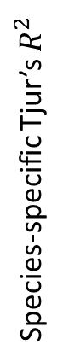
The inclusion of spatially structured latent factors improved the model’s ability to predict the validation data
Covariates and latent factors, mean = 0.42
Species-specific Tjur’s $R^{2}$
Covariates only, mean = 0.30
Prevalence

Slide 34
STPTJSDM (spatio-temporal phylogenetically constrained trait-based joint species distribution model)
Y
X
Occurrence
Environment
Space and time
sampling units
2000
1980
species
covariates
C
T
Phylogeny
Traits
species
species
traits
Ovaskainen et al. (ms)

Slide 35


Software
Environmental covariates
Traits
Presence-absence data
Co-occurrence through latent variables
Abundance (and other kinds of) data
Phylogenetic correlations
Spatio-temporal latent variables
Latent variables that co-vary with measured covariates
Time-series models
Etc.
In preparation
Interested in contributing? Post-doc (and other) funding available for 2016-2017
Contact: otso.ovaskainen@helsinki.fi

Slide 36
Conclusions
There is a lack of statistical frameworks that would enable one to infer metacommunity processes from data typically available in community ecological studies.
Joint species distribution modelling is one fast developing area which tries to fill this gap.
A lot of relevant structures can be built into generalized hierarchical linear mixed models: hierarchical layers, covariance structures, error structures and link functions.
The joint species distribution models presented here are of general nature and thus applicable to many kinds of study systems and study questions.
More refined information on specific systems may be obtained by other approaches (e.g. process-based state-space models).
Global

